Slide 1
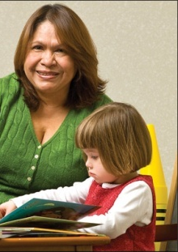
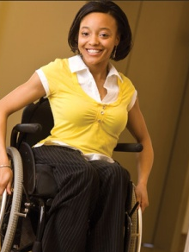
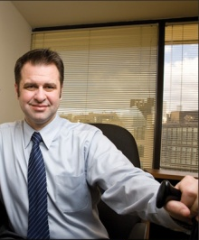
Techniques, Tools, and Technologies for Creating Inclusive Workplaces
Lou Orslene, JAN Co-Director
Orslene@jan.wvu.edu
March 2019
Notes:
Good afternoon everyone. I am grateful for this opportunity to speak with you about Tools, Techniques, and Technologies for creating inclusive workplaces.
And thank you for the introduction ???????.

Slide 2

Topics
JAN Services
Disability Inclusion Revolution
Inclusionary –
Techniques
Tools
Technologies
- throughout the employee life cycle.
Notes:
In the next 40 minutes, I plan to talk abit about the our services, the workplace implications of the ADA, the interactive accommodation process, and then share best practices for hiring and onboarding individuals with disabilities.

Slide 3
Key to Inclusive Culture
Accommodation
=
Equal Employment
=
Inclusive Workplace Culture
Notes:
I have a firm belief that the Key to a Disability Inclusive Culture is having an effective accommodations policy and process.
If a company is effective in accommodating its employees then it will meet its compliance obligations and create a culture that is informed on disability issues.

Slide 4
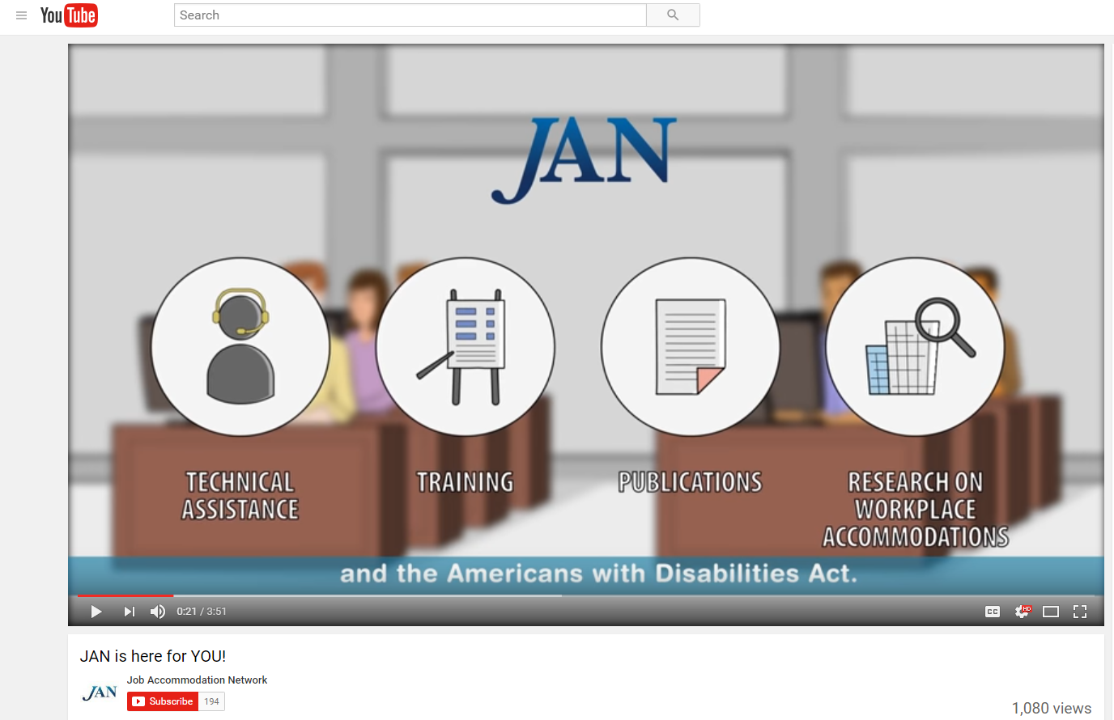
Who is JAN?
Notes:
The Job Accommodation Network (JAN) is the leading source of free, expert, and confidential one-on-one guidance on reasonable accommodation (RA) in the workplace, the Americans with Disabilities Act (ADA) and related legislation, and disability employment issues.

Slide 5


Disability Inclusion Revolution
Over 1.3 billion people across the world live with some form of disability.
World Bank Group
Together with their friends and family, this group has a spending power of $8 trillion.
Global Economics of Disability Report
Notes:
It is important to note from the outset that there is ability beyond disability. Disabilities, impairments, and chronic health conditions are a natural part of being human. We may be born with them or cycle in and out of disabilities through injury and recovery.
There are more than 56 million people in the US - or nearly 1 out of 5 people – who self identify as people with disabilities. And most have disabilities such as diabetes, cancer, a learning disability, or mental health condition that are non apparent to the rest of us.
And many individuals who report a disability are of working age and in our workplaces and are consumers.
So the better prepared we are in understanding disability, reasonable accommodation, and inclusion, the more fair and equitable our workplaces will be. And, research suggests that having a diverse and inclusive workplace also insures a productive workforce and success in the marketplace.

Slide 6
Disability Inclusion Revolution
Companies that championed people with disabilities outperformed others -
  Revenues were 28% higher, net income 200% higher, and profit margins were 30% higher.
Companies that improved internal practices for disability inclusion -
  were almost four times more likely to see higher total shareholder returns.
Getting to Equal: The Disability Inclusion Advantage
https://www.accenture.com/t20181029T185446Z__w__/usen/_acnmedia/PDF-89/Accenture-Disability-Inclusion-Research-Report.pdf
Notes:
Disability has also become an emerging market for a growing number of enterprises. So more than ever there is a value proposition to hiring people with disabilities and involving these employees in the development and marketing of products and services.
Often, these days I hear of products designed for “ease of use”, or “designed for all”, or “universally designed”. This shift in thinking about consumers and particularly about consumers with disabilities is signaling fundamental market changes. Microsoft is a great exemplar here. Believing that “disability is an engine of innovation”, Microsoft and its “design for all” effort was featured in a recent Fast Company article.
According to an Association of National Advertisers blog, people with disabilities globally control $8 trillion dollars in disposal income, and together with their friends and family represent 53% of global consumers.
According to the author of this blog, people with Disabilities (PWD) are positioned to be the focus of brands within the next five years.
Marcus Robinson in his book, “The Business Case for Inclusion and Engagement”, writes that marketing programs aimed at people with disabilities can reach as many as four out of every 10 consumers. As the largest of all U.S.-based minority groups, this group is comprised of people of all ethnic backgrounds, cultures and ages.
And we know from 2006 study conducted by Siperstein and Romano that “…87% of survey participants specifically agreed that they would prefer to give their business to companies that hire individuals with disabilities.”
Thus, disability is becoming mainstream in the workplace and influencing many of the products and services we use.

Slide 7
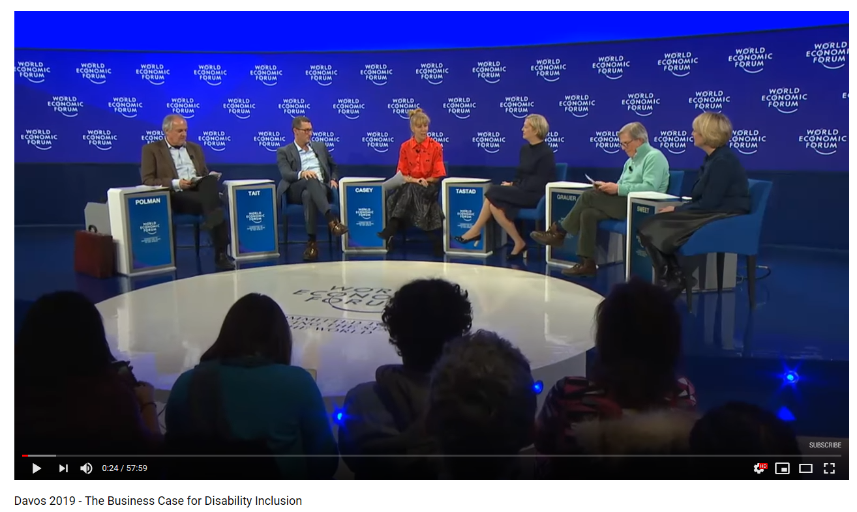
Disability Inclusion Revolution
    https://www.youtube.com/watch?v=SrSmhK_RqdY
Notes:
http://www.businessanddisability.org/news/the-valuable-500-launches-at-the-world-economic-forum-annual-meeting-to-promote-disability-inclusion-in-business/

Slide 8
Disability Inclusion Revolution
    Drive Innovation - Apple VoiceOver on iPhone
    Enhancing Your Brand - Barclays Beacon Technology
    Increase Market Reach - NRP Weekly Broadcast
    Minimize Legal Risk - Increasing Court Cases and Settlements
    https://www.w3.org/WAI/business-case/
Notes:
Business case for accessibility
VoiceOver on iPhone: Early in the evolution of the iPhone, Apple began considering the implications that a touchscreen device would have on their blind customers. Iterating over several years behind the scenes, the company invested the resources to develop the voice technology that led to VoiceOver, the world’s first gesture-based screen reader. Within weeks of launch, Apple received a special commendation from the National Federation of the Blind “For designing the first fully accessible touchscreen interface.”
Barclay’s Beacon tech https://www.youtube.com/watch?v=c4du2x4d99g&index=2&list=PLecqH2uhOR0Zb31X7hh5BzWJv4KGLnuUy
This American Life is a broadcast heard on more than 500 National Public Radio (NPR) stations by about 2.1 million listeners each week in the United States. In 2011, in response to new regulations around broadcast media from the US Federal Communications Commission (FCC), the broadcaster committed to creating transcripts for their entire archive of recorded programs. A study by their media partner, conducted over several months, concluded that the provision of transcripts not only met legal obligations but returned significant benefits including:
search traffic increased 6.86%,
better comprehension for visitors who use English as a second language,
visitors were able to use transcripts in noisy or sound-sensitive environments,
ability to more easily translate, and
ability to search text to reference a specific section of audio.
A significant demonstration of the risk of ignoring accessibility requirements was the 2008 settlement by the National Federation of the Blind with Target retailers:²⁰
class damages of $6 million
plaintiff legal fees over $3 million
undisclosed defense legal fees
court oversight of website for several years

Slide 9
Disability Inclusion Revolution
The Conference Board – established to support businesses reports disability in the workplace is a critical issues of our time.
Trends noted in the report:
      Employees aging in the workplace
      Development of new, more universally accessible workplace technologies
      Greater acceptance of remote work
      Health care advances
      Incentives provided by government
Source: The Conference Board, “Leveling the Playing Field: ATTRACTING, ENGAGING, AND ADVANCING PEOPLE WITH DISABILITIES.”
Notes:
The Conference Board, established to help private industry understand and deal with the most critical issues of our time, believes disability in the workplace is one of these critical issues. The trends driving inclusion including:
Employees aging in the workplace
Development of new, more universally accessible workplace technologies
Greater acceptance of remote work
Health care advances
Incentives provided by government
Americans with Disabilities Act, as amended (ADAAA)
Section 503, 508, 501 of the Rehabilitation Act of 1973
Executive Order 13548
Workforce Innovation and Opportunity Act (WIOA

Slide 10

Disability Inclusion Revolution
10,000 baby boomers reaching age of 65 every day
In 2010, 19% of people with disabilities have reportedly graduated from college …up from 14% in 2004
47,000 service members
  have been wounded in
  action. Hundreds of
  thousands more, nearly
  25 percent of all who
  served, will be diagnosed
  upon returning home with
  other “invisible wounds”
Notes:
So who are talking about - people with disabilities, chronic health conditions, and life long injuries.
10,000 baby boomers reach the age of 65 every day.
Many of these boomers are deciding not to retire or are starting a new career. Thus, more than ever the workforce will be impacted by the chronic health conditions of aging workers. It is estimated that by the year 2020, half of the U.S. population will have at least one chronic condition and one-quarter will be living with multiple chronic conditions.” This information is from Center on an Aging Society, Georgetown University.
In 2010, 19% of people with disabilities have reportedly graduated from college, up from 14% in 2004.
The expectations of work for young people with disabilities are high as we now are seeing the first generation of young people who have benefited from the 1975 Individuals with Disabilities Education Act. With graduation rates growing, more young people who have benefitted from school mainstreaming are entering the nation’s workforce. These qualified young people have been empowered by the ADA and expect to work and expect not to be hindered by the barriers of the past.
47,000 service members have been wounded in action. Hundreds of thousands more, nearly 25 percent of all who served, will be diagnosed upon returning home with other “invisible wounds.”
Increasingly, the private and public sector are filling their ranks with veterans, including our wounded warriors. Leading the way are companies such as Lockheed Martin and Northrup Grumman.

Slide 11
Disability Inclusion Revolution
What is your value proposition?
  Increase of market share
  Increase the talent pool
  Increase in workplace productivity
  Increase in innovation
  Increased safety
  Decreased risk
  Increased company morale
Notes:
Development of an internal business case shared with everyone, legitimized by an executive sponsor and shared in particular with talent acquisition staff and managers

Slide 12
Cultural Change
Increase Comfort, Confidence, and Competence of all employees
Skills that help to more effectively communicate at work with people with disabilities
Effective, transparent, and actionable policy and procedures that are executed on a timely basis
Normative practices for engaging with people with disabilities throughout the employee life cycle
Notes:
There is decades of research suggesting that the primary barrier to disability inclusion is attitudes. Attitudes reflecting old, tired myths that people with disabilities are “them” not “us”. Or that people with disabilities are less safe, use more health, are less productive, or that workplace adjustments are expensive. So creating inclusive workplaces are two fold – creating a culture of respect for everyone including people with disabilities and instituting or normalizing the disability. This works begins with understanding increasing the comfort, confidence, and competence of all employees on issues of disability.
Organizational readiness

Slide 13
Checking for Inclusion
Accessible buildings
Inclusive ethos - particularly language
Inclusive public relations and marketing, particularly on social media
Collaborative and authentic relationships with national and local resources to recruit/retain talent with disabilities
Digital Accessible
Actionable and transparent accommodation policies and practices
Notes:
Take a secret shopper approach audit your workplace.
pain points business seem to be dealing with most ften.
Applicant Tracking Systems
Pre-hire Testing Software
Accommodation Tracking Systems
Legacy Information Systems i.e. HRIS
Learning Management Systems

Slide 14
Checking for Inclusion
So what is your practice?
Whose responsibility it is to request accommodation?
What happens after a request? What is the internal process and who is involved? What are the touchpoints?
What is the timeframe for processing requests? Expedited process for procurement particularly for applicants?
But what happens if there is a delay?
What is a temporary accommodation?
Who communicates the determination?
Is there an appeal process if one is denied? What is the process?
How are accommodations tracked?

Slide 15
Techniques for Inclusion
Focusing on diverse abilities and contributions to productivity goals instead of disability
Adopting facilities/IT access for all/universal design to reduce the need for individualized accommodations
Develop an integrated or harmonized model, including a single point of contact for leave and accommodation along with a centralized funding stream
Designate a person to address digital accessibility – IAAP certified
Notes:
Applicant Tracking Systems
Pre-hire Testing Software
Accommodation Tracking Systems
Legacy Information Systems i.e. HRIS
Learning Management Systems
JAN Accommodation Toolkit
Mobile Accommodation Solution

Slide 16
Techniques for Inclusion
Develop a list of preapproved accommodations not requiring a full assessment and interactive process
Purchase or develop an accommodation tracking system
Gathering/reporting meaningful metrics (e.g. accommodation inquiries, provided, denied, appealed, days lost to inaction)
Benchmarking against peers Disability:IN or NOD
Encouraging all employees to be visible/engaged allies

Slide 17
Techniques for Inclusion
Developing a “task bank” of jobs that an employee with a disability or injury can perform to keep them engaged with the workplace
Training and more training particularly for hiring managers and supervisors – consider building educational prompts into the enterprises information system to guide employees
Use outside resources more effectively – do not recreate the wheel internally
Provide boilerplate accessibility contract language to contract officers

Slide 18
Techniques for Effective Accommodations
The basis for inclusive employment is the reasonable accommodation (RA) policy and process
The foundation for reasonable accommodation is a robust interactive process (IP)
The trigger for RA and IP is a request for an accommodation or recognition of an obvious barrier to someone with a known disability
A request for accommodation includes two essential elements – a medical condition and a related challenge at work

Slide 19

Techniques for Effective Accommodations
What is the Interactive Process (IP)?
A collaborative effort to identify effective accommodation solutions – it’s that simple.
Creates a standard of practice
Facilitates communication and inclusion
Demonstrates good faith
Leads to ADA/Section 503 compliance

Slide 20
Techniques for Effective Accommodations
JAN’s Interactive Process
Step 1: Recognizing an Accommodation Request
Step 2: Gathering information
Step 3: Exploring Accommodation Options
Step 4: Choosing an Accommodation
Step 5: Implementing the Accommodation
Step 6: Monitoring the Accommodation
http://AskJAN.org/media/eaps/interactiveprocessEAP.doc

Slide 21
Techniques for Effective Inclusion
Recruiting Talent with Disabilities
Feature your EEO statement on career portal includes disability
Develop partnerships with CSAVR, NTID, Lime Connect, Bender, Sierra group
Develop internships and partner with WRP, Emerging Leaders, EntryPoint!
Use disability focused job bank – Ability Jobs, Gettinghired.com, Hire Disability
Train recruiters and hiring managers on what a disclosure looks like and what to do with it
Train recruiters and hiring managers in disability etiquette and awareness training
Provide a disability subject matter expert for more complex situations
Have an expedited procurement process for accommodations during the hiring process

Slide 22
Techniques for Effective Inclusion
Inform Ahead of Time
Describe the hiring process
Inform about employment testing ahead of time
Inform how to request accommodation
Follow up on requests without delay
“If you require reasonable accommodation in completing this application, interviewing, completing any pre-employment testing, or otherwise participating in the employee selection process,
please direct your inquiries to…”
Notes:
Some best employer practices for preparing candidates but particularly candidates with disabilities include a note in advance detailing the interview process, informing them if there is pre-employment testing and how it is conducted, and how they if needed they can request an accommodation.
Important to say at this point that not all people with disabilities even one’s who disability is apparent to you will need an accommodation. But having the policy front and center provides them with the opportunity to inform you and make the request. What you do not want to happen, for instance, is that you have not informed the candidate and then they show up for an interview needing an interpreter which is very challenging to secure at a moments notice or a individual in a wheelchair can’t get through the conference room where you are conducting the interview.
A sample of a reasonable accommodation statement is provided on the screen. It READS GO TO SLIDE

Slide 23
Techniques for Effective Inclusion
Evaluate the interview and testing site:
Notify candidates in advance about parking/site specific information
Can the candidate access:
    the parking area?
    your front door?
    the interview room?
    the restroom?
Are the staff who are greeting candidates knowledgeable about the basics of disability etiquette?
Know your accommodation process
If not accessible, be gracious and reschedule
Notes:
So that you are comfortable and confident for the interview, you will want to think about the interview process and testing site in terms of basic accessibility.
GO TO THE SLIDE.

Slide 24
Techniques for Effective Accommodation
Enforcing a policy related to fragrances
Providing a reader or interpreter
Modifying tests or training materials
Allowing a support person to attend the interview
Allowing access for a service or emotional support dog
Common Inclusion Accommodations for Interviewing, Hiring, and On-boarding:
Inform applicants candidates, new hires of process
Ensuring accessibility of applicant tracking system
Modifying application policies and procedures
Materials in accessible formats
Notes:
So what are some typical accommodations we should be prepared to provide as talent acquisition professions.
On the slide we see a number of these.
PROVIDE EXAMPLES FOR SOME OF THESE.

Slide 25
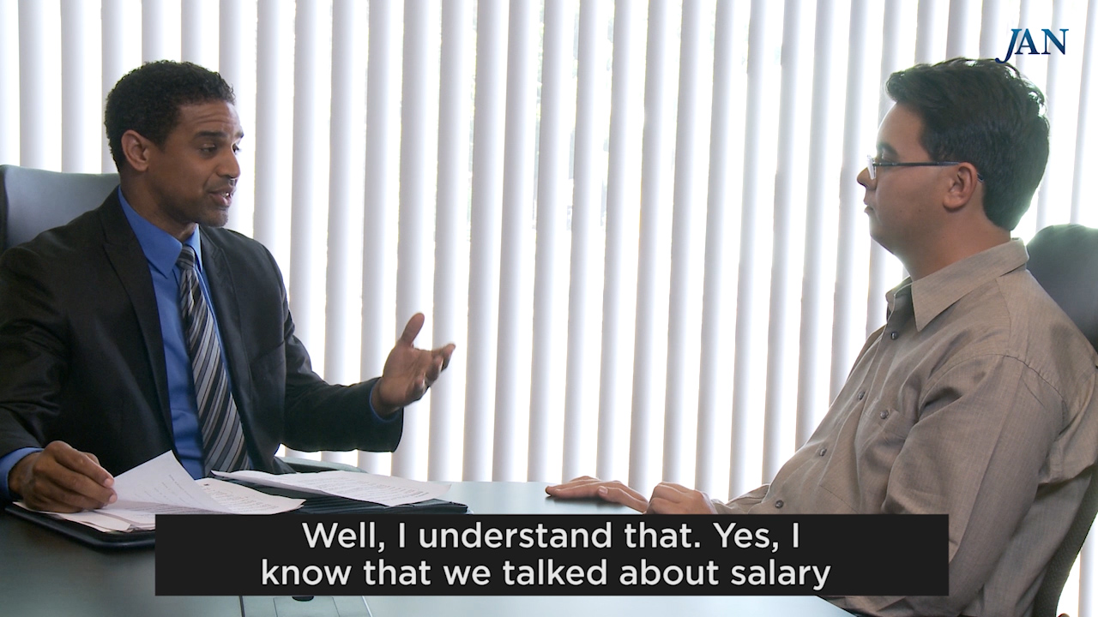
JAN Video: Interviewing

Slide 26
Frequently Asked Question #1
Can I ask a disability related questions in the pre-employment stage?
General rule: medical inquiries and exams are not allowed at this stage
Exceptions:
If an applicant asks for an accommodation for the application/interview process, the employer can require medical documentation to show that the applicant has a disability and needs the requested accommodation.
If an applicant has an obvious or known (e.g., the applicant disclosed) disability and the employer has a reasonable belief that the disability will interfere with job performance, the employer can ask the applicant to demonstrate or describe how he would perform the job and what accommodations he might need.
Notes:
Pre-Employment, Pre-Offer
May employers ask applicants if they will need accommodation to perform job functions, if hired?
Sometimes
Must have reasonable belief that accommodation will be needed to perform job functions…
Because of an obvious disability
Because of a hidden disability the applicant has voluntarily disclosed
Because the applicant has voluntarily disclosed the need for accommodation
After first bullet mention – 1st bullet - Obtain information needed to determine if applicant is qualified
After second bullet mention - 2nd bullet- Ask job-related questions – not disability-related - Likely to elicit information about a disability
After the third bullet mention - 3rd bullet – You can ask a particular applicant to describe/demonstrate how s/he would perform the job only when two conditions are met - when: the person has disclosed there disability or their disability is obvious AND There is reasonable belief that an applicant will not be able to perform a job function because of the known disability. An example might be that a candidate uses a wheelchair and you have hired them for a warehouse position where they need to lift and carry.
However, if you ask all candidates to describe/demonstrate how s/he would perform the job, then you could ask this of individuals with a disability as well.
Thinking this process through and asking the right questions will ensure that you base hiring decisions on skills, qualifications, and experience.
Post-Offer & Disclosure
If employers ask disability-related questions during the post-offer stage, are individuals required to disclose disability-related information?
Usually – Employers may condition job offers on the satisfactory completion of a medical questionnaire or examination
Can limit type and amount of information shared, but be truthful

Slide 27
Techniques for Effective Accommodation
Common Inclusion accommodations for
Stay-at-Work:
Modifying schedule or allowing leave time
Making workplace or work station accessible
Modifying methods communication, supervision, etc.
Modifying or creating policies
Purchasing or modifying equipment or products
Purchasing a service — reader or interpreter
Restructuring job
Reassignment

Slide 28
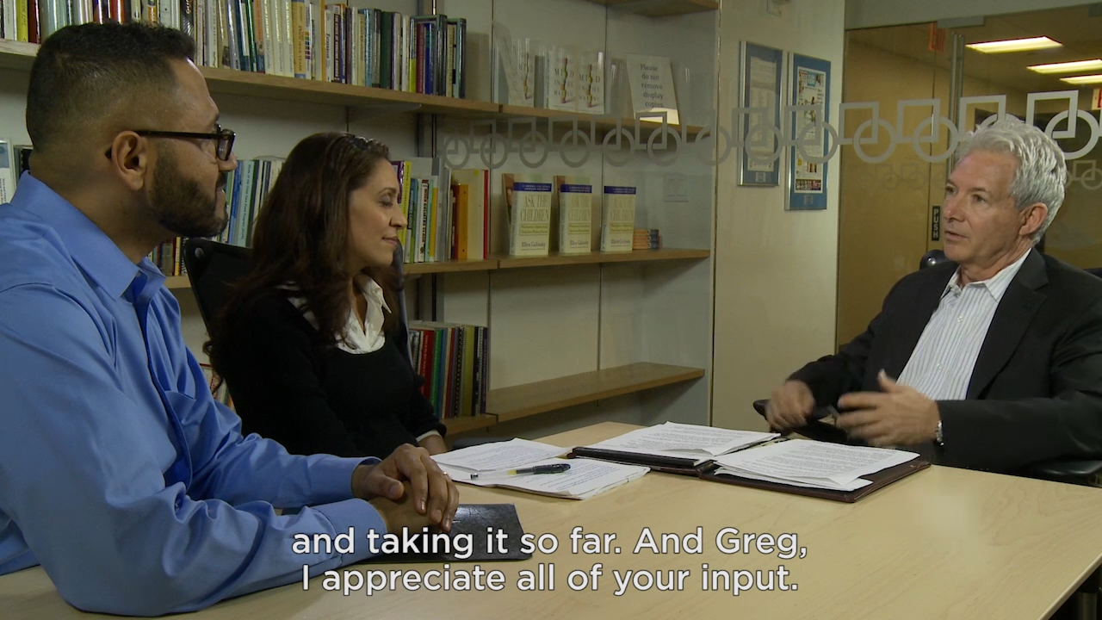
JAN Video: SAW/Retention

Slide 29
Frequently Asked Question #2
Can I discretely tell co-workers about an accommodation provided to an employee?
General rule: NO
“I’m not going to discuss other employees with you, but if there is a reason you need to change the way you work, I’d be happy to discuss it with you.”

Slide 30
Techniques for Effective Accommodation
Re-engineering of worksite
Restructuring job
Reassignment
Common accommodations for
Return-to-Work:
Transition Program
Modified schedule
Temporary Reassignment
FMLA, Short Term Leave
Notes:
“The fundamental reason for most lost workdays and lost jobs is not medical necessity, but the non-medical decision-making involved in and the poor functioning of the stay-at-work/return-to-work (SAW/RTW) process.”
The SAW/RTW process presently focuses on “managing” or “evaluating” a disability rather than preventing it.
Preventing Needless Work Disability by Helping People Stay Employed
American College of Occupational and Environmental Medicine
Published in September 2006 JOEM
This process determines whether a worker stays at work despite a medical condition or whether, when, and how a worker returns to work during or after recovery. This report describes the SAW/RTW process, presents recommendations to improve the process, and provides information on current best practices and initiatives.
his report focuses on the large number of people who due to a medical condition that should normally result in only a few days of work absence, end up withdrawing from work either permanently or for prolonged periods. For many of these workers, their conditions began as a common problem (e.g., a sprain, strain, depression, or anxiety), but escalated resulting in short-term, long-term, or permanent disability. This potentially preventable disability absence has unfortunate consequences for both the employer and the employee

Slide 31
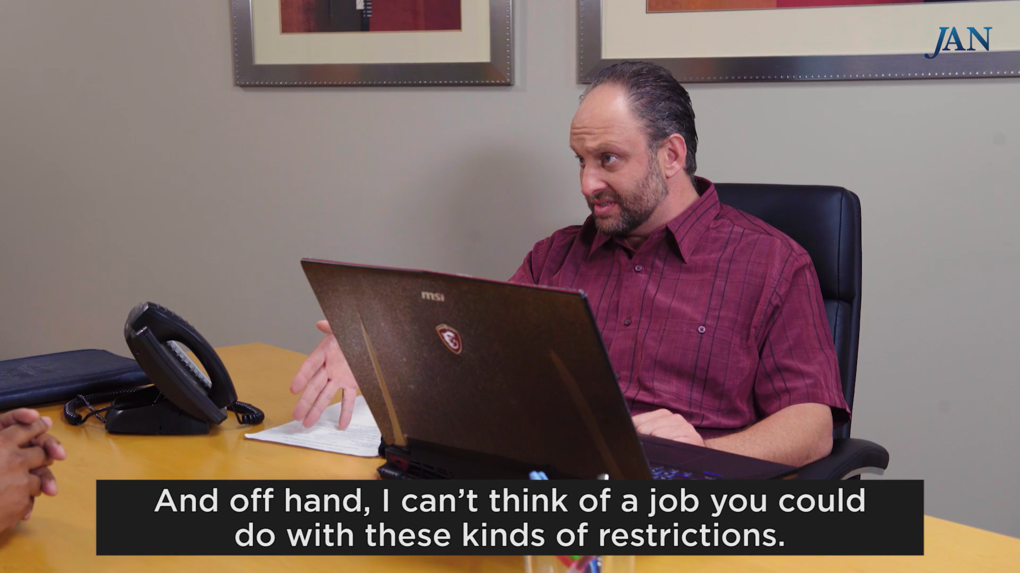
JAN Video: Return-to-Work
Notes:
https://www.csg.org/seed_report.pdf
Research has shown that the likelihood of a person return-ing to full employment drops significantly after six months of absence, and the odds of a worker ever returning to work drop to 50 percent by the 12th week after injury or illness onset, and after 52 weeks the chance of ever returning to work decreases to almost zero.16 Many injured or ill workers could remain in their jobs or the workforce if they received timely, coordinated, effective supports and services as part of SAW/RTW programs.1

Slide 32
Frequently Asked Question #3
Does our Workers’ Compensation Team have ADA responsibilities?
General rule: YES
As soon as an injured employee is diagnosed with a permanent disability then the interactive process should begin.

Slide 33
Techniques for Effective Accommodation
Ensure accessible opportunities to engage with other employees
Look at your metrics to ensure advancement is occurring
Common Accommodations for Advancement Promotion:
Mentoring
Ensure training opportunities are accessible
Ensure travel opportunities are accessible
Notes:
Mentors can provide support, counsel, and constructive
examples for employees with disabilities as they acclimate
to the work environment and their job responsibilities, as
well as throughout their career life cycles.168 A 2010 study
reported that almost one-fifth (18 percent) “of employed
people with disabilities are matched with a mentor at
work”; 72 percent of “employees with disabilities who have
mentors agree[d] that [their mentors] play an important
role” in their success at work. 169

Slide 34
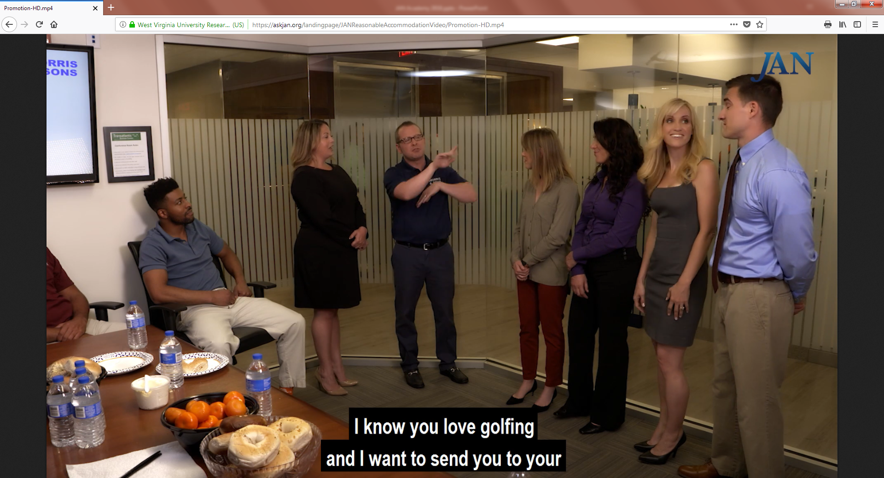
JAN Video: Advancing
Notes:
DD tee up video

Slide 35
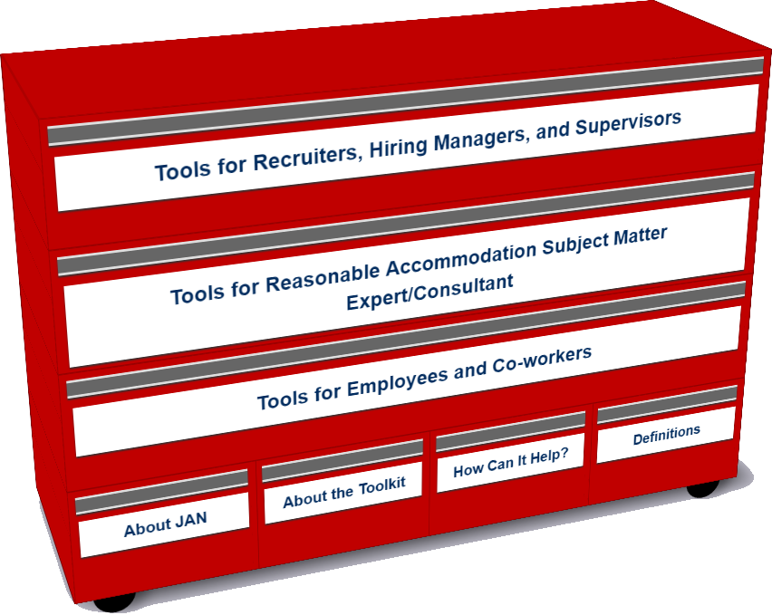
Who uses the Toolkit?
Recruiters, Hiring Managers and Supervisors
Accommodation Consultant/Subject Matter Expert
Employees and Co-workers — Allies
http://AskJAN.org/toolkit/
Notes:
An free, online “living” toolkit that captures and continuously updates best and emerging practices in providing accommodations in the workplace.
Many companies have noted that they could benefit for emulating best/emerging RA practices including:
Easier-to-navigate RA processes for employees and managers
Better mechanisms for tracking and reporting
Enhanced data-gathering practices (to gauge how satisfied employees and their managers are with RAs, financial savings, return to work, etc.)
More transparent and effective intersections between Section 503 self-ID encouragement and identifying as a person with a disability for purposes of obtaining an RA

Slide 36
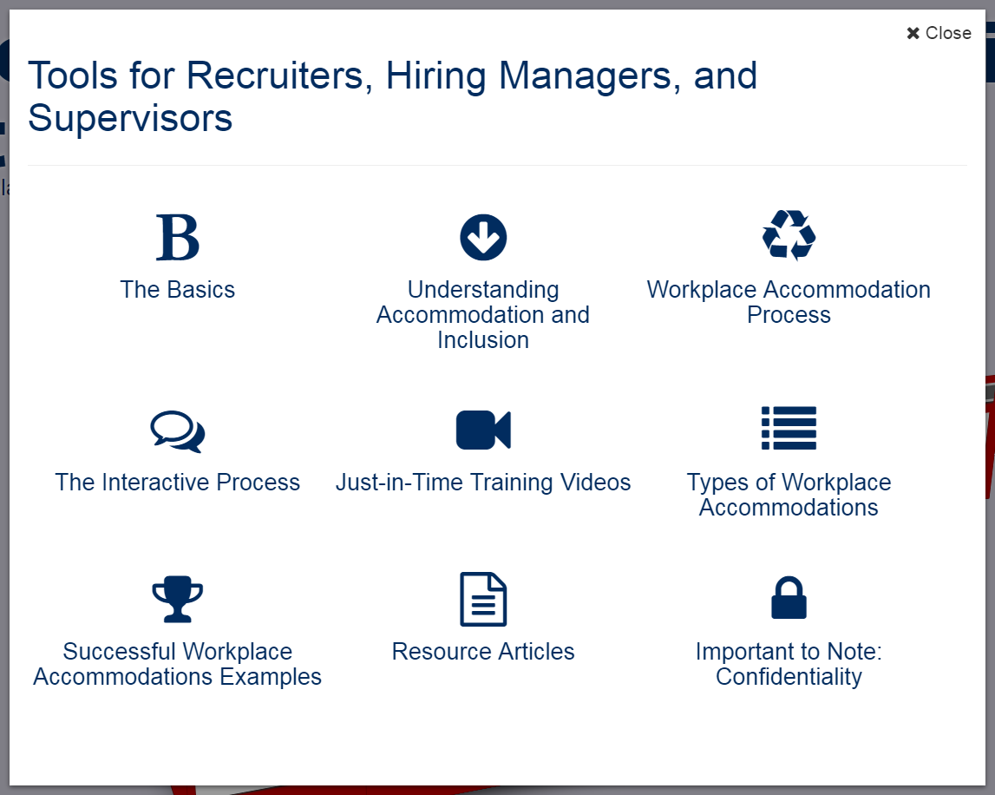
Accommodation Toolkit
Recruiters, Hiring Managers and Supervisors
Notes:
LO

Slide 37
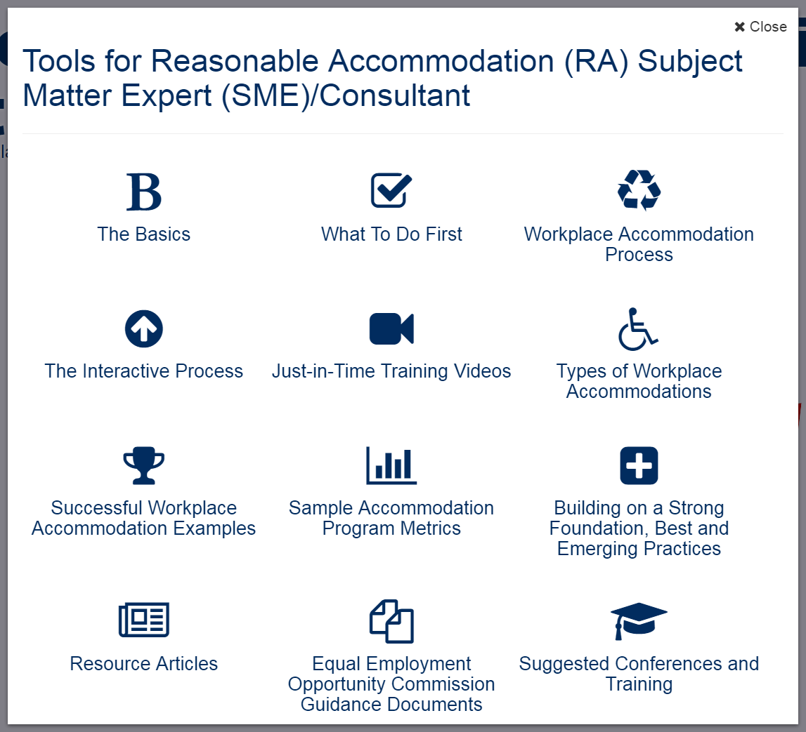
Accommodation Toolkit
Accommodation Consultant/Subject Matter Expert
Notes:
LO

Slide 38
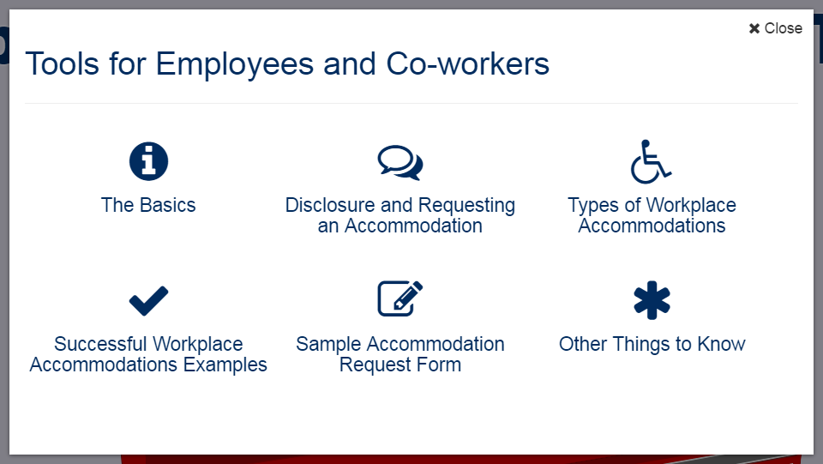
Accommodation Toolkit
Employees and Co-workers — Allies
Notes:
DD

Slide 39
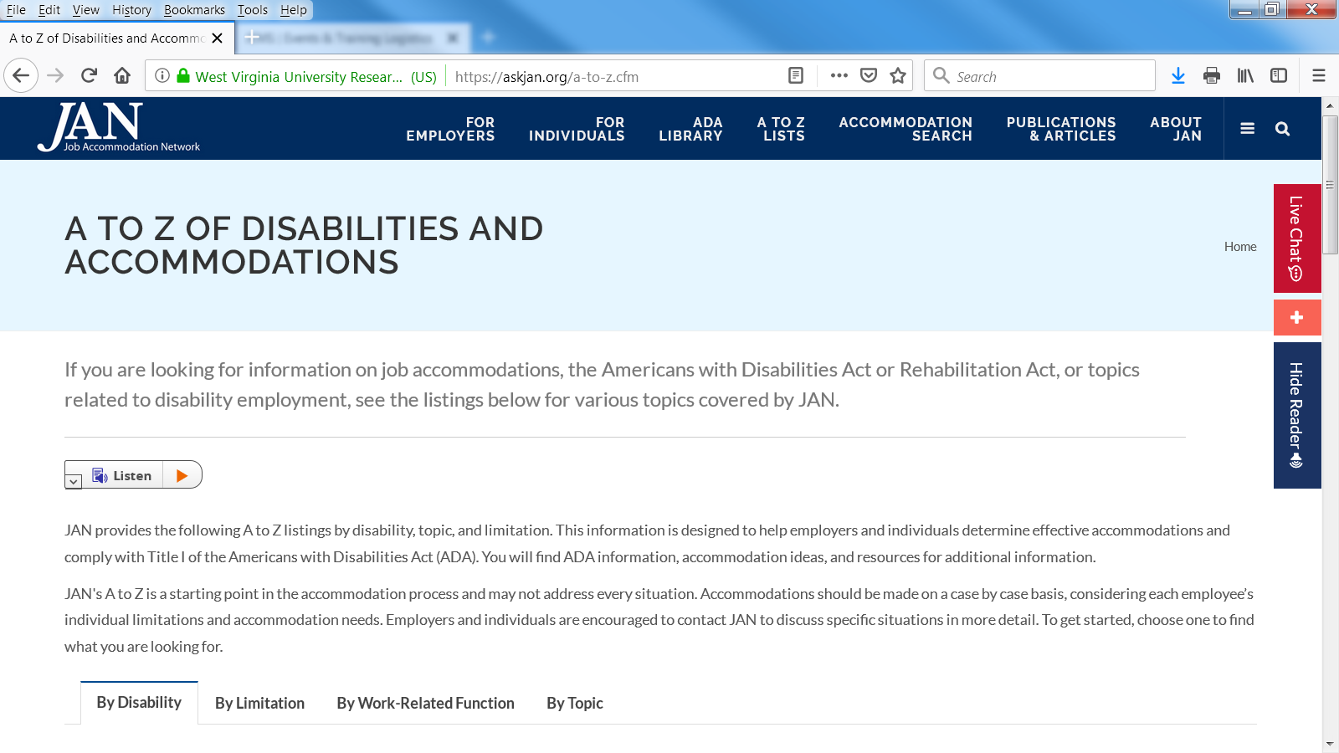
Tools for Accommodating
A – Z of Accommodations

Slide 40
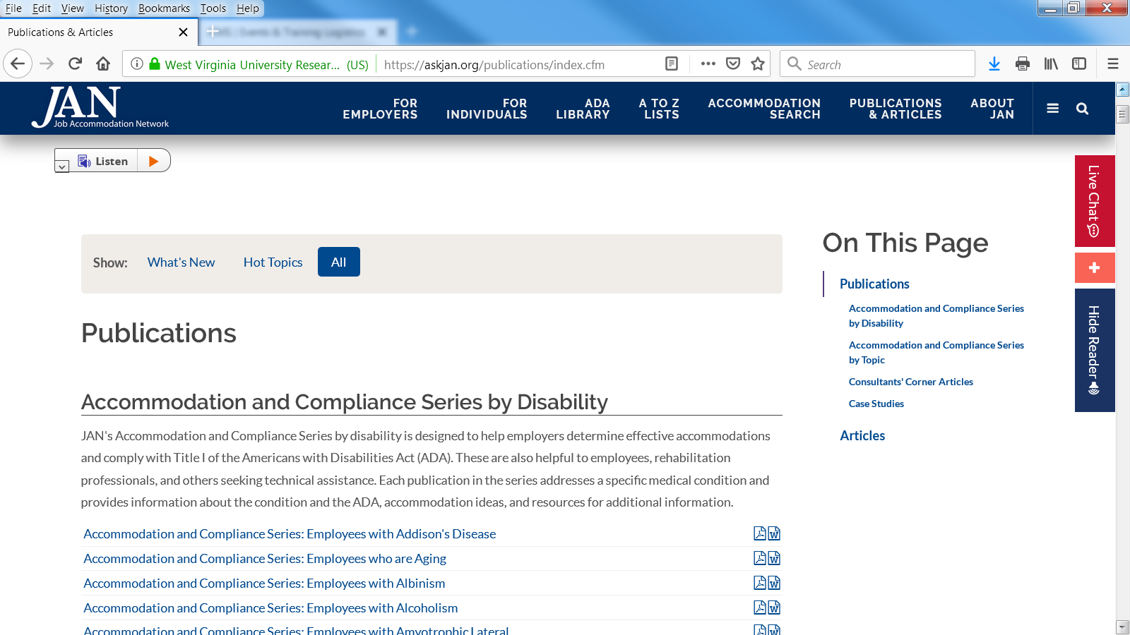
Tools for Accommodating
Publications

Slide 41
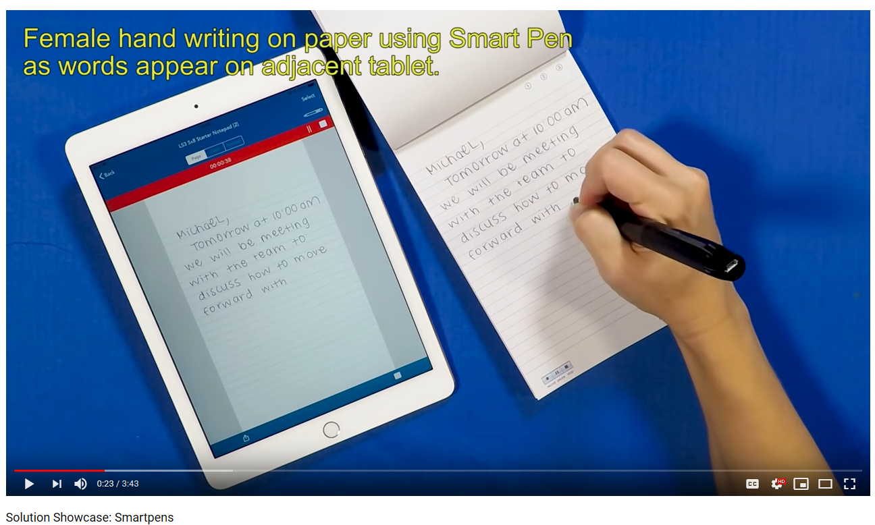
Solution Showcase
Technologies for Accommodating
https://AskJAN.org/events/Multimedia-Training-Microsite.cfm
Notes:
DD tee up video

Slide 42
Free MAS App
Technologies for Accommodating
Big Idea
The Mobile Accommodation Solution (MAS) is designed to help streamline the disability accommodation process at various phases of the employment cycle.
Funded by the National Institute on Disability, Independent Living, and Rehabilitation Research (NIDILRR)
Notes:
Collaborators
Center for Disability Inclusion
Job Accommodation Network (JAN)
IBM
US Business Leadership Network
American Association of People with Disabilities
Council of State Administrators of Vocational Rehabilitation
National Business and Disability Council
Disability Management Employers Coalition

Slide 43
Technologies for Accommodating
Users
Talent management, human resources, employer relations, and/or accommodation staff
Employment service providers
Applicants and employees with disabilities

Slide 44
Technologies for Accommodating
Functionality
Easy to use, secure, mobile case management tool
Accommodation tracking tool
Best and emerging accommodation practices and forms embedded within tool
Easy access to JAN Consultants and myriad of other resources

Slide 45
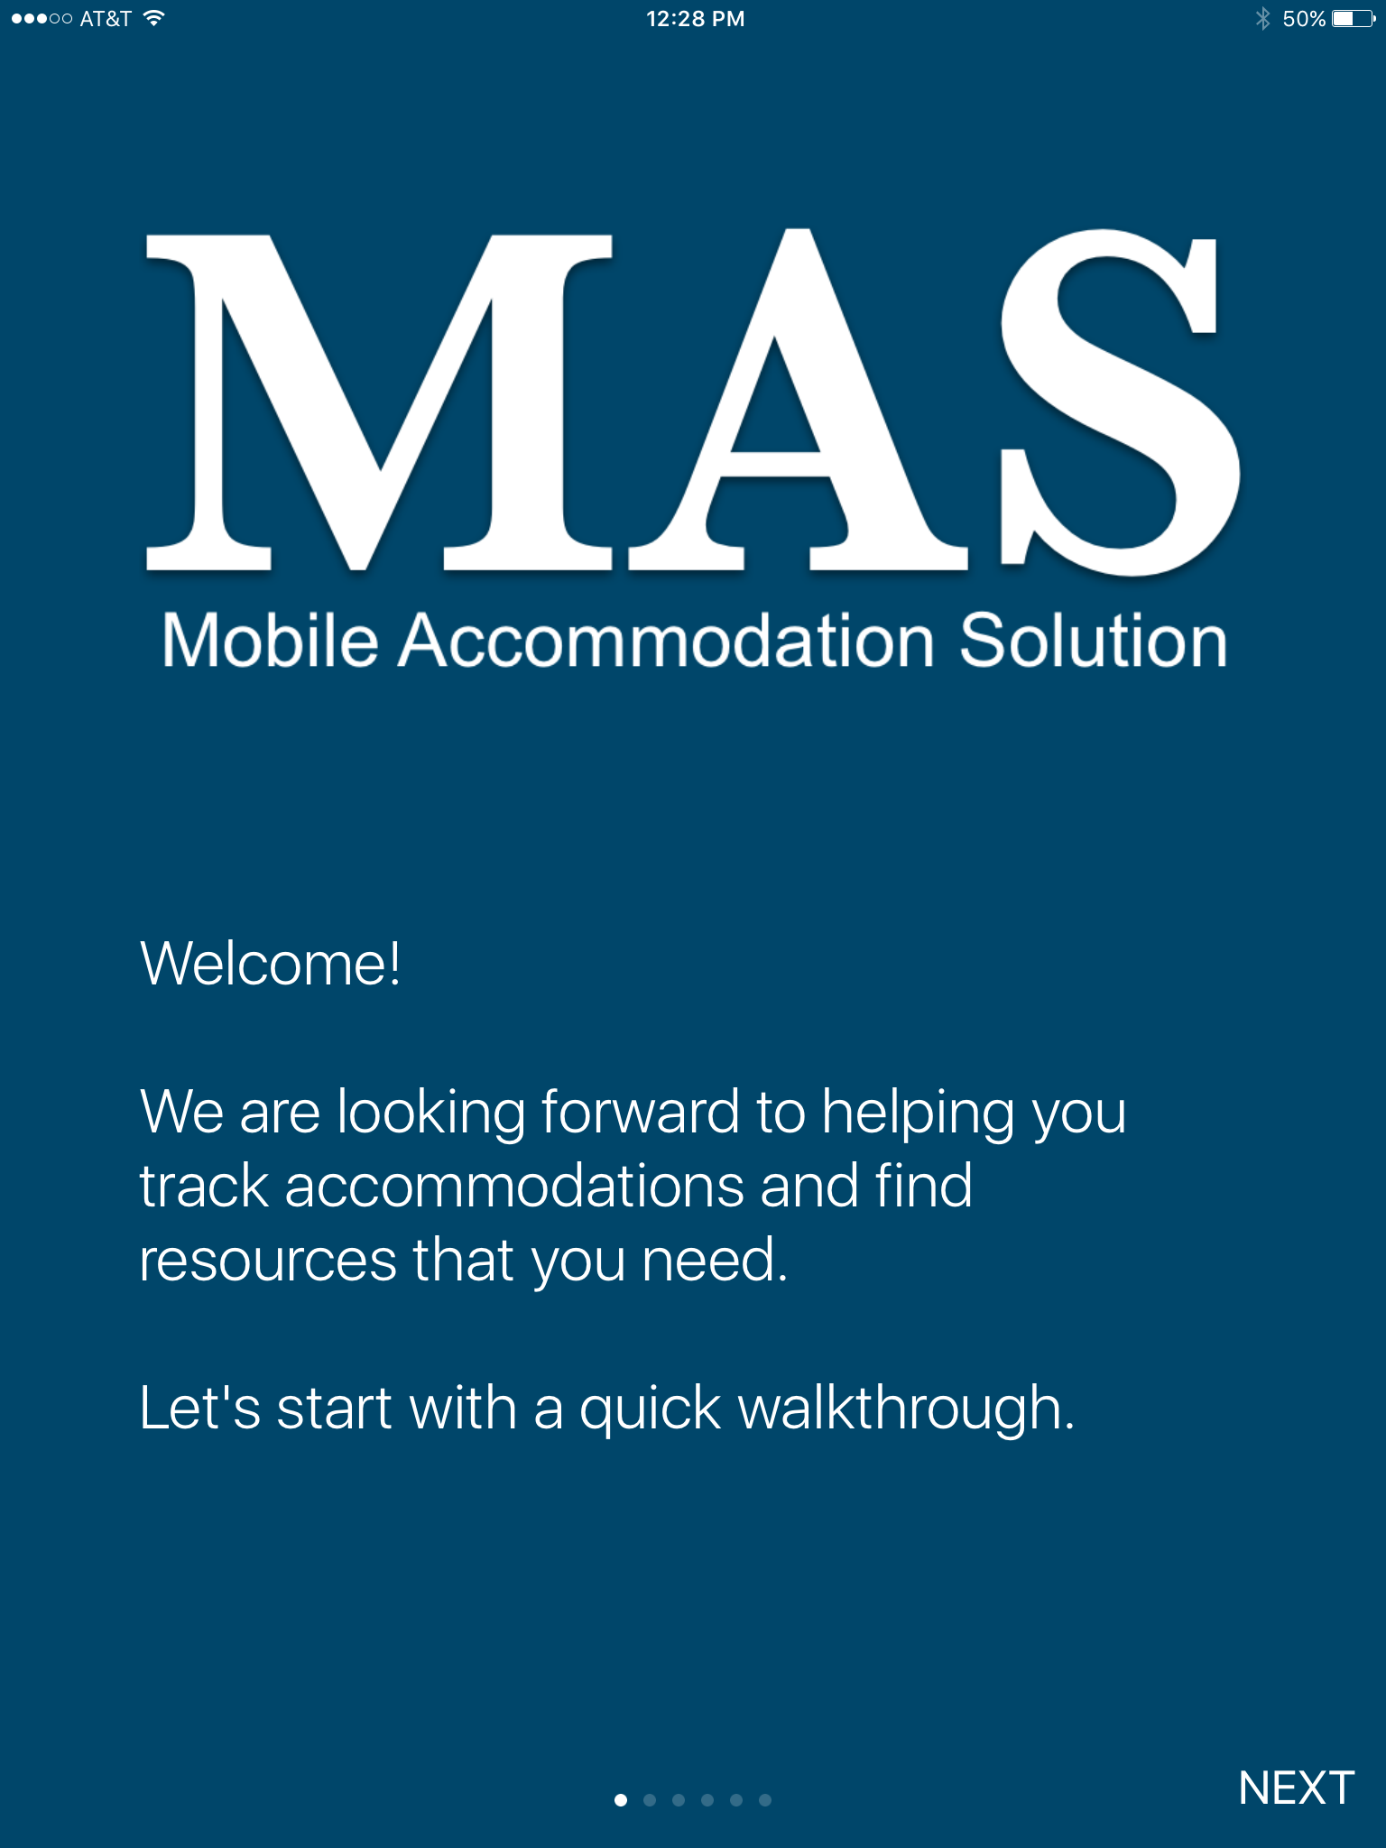
Technologies for Accommodating

Slide 46
Next Big Tool
IT Drawer within the Accommodation Toolkit
Resources for information technology professionals who are tasked with responding to internal and/or external digital accessibility requests.
Notes:
Business case - IBM
Job description of accessibility specialist point of contact - from EY - Kevin Grogg
DD: Charter Communications can also provide job description if you want another example
Top 5 things to do when starting in this position
DD: maybe “role” or “taking on this responsibility" instead of position since may be part of job that is informally designated
What is accessibility, AT, access for all
Interoperabiliity - share example of blind person not working for two months while the technology is being worked out.
DD: Maybe also an example of a customer service center that cannot hire individuals who are blind/low vision? Could your team write up a generic example based on inquiries received not attributed to anyone one company or app?
How to work with hr and employees. Communication - develop blog and video with Kevin at EY
Deeper into access for all. What technology for communication, training, tracking - again hopefully with Kevin’s help
DD: Maybe interview Tom Wlodkowski at Comcast or otherwise do a write up of a blind person working with IT and communications challenges when installing an AT tool like JAWS. Also at the Inclusion Works meeting an issue in this area that came up is that when there is a new Security “patch” or new app installed, employees with disabilities using access solutions find that they lose access and have a difficult time getting the support they need on a timely basis to restore productivity.
What are accommodations involving AT and accessibility
Types of accommodation
Types of AT. JAN AT Solution Videos
Procurement
DD: Working with vendors and sample boilerplate contract language for both RFP’s and Master Service Agreements that includes commitment to WCAG 2.1 accessibility. Perhaps also example of how to raise this issue with a vendor in between contract negotiations?
Best and emerging practices.
Conferences to attend - ATIA CSUN,
DD: M-Enabling
Shall we list some vendors e.g:
DD: Maybe a section on the importance of obtaining/sustaining CIO Executive Sponsorship for digital accessibility and perhaps a quote from a CIO or two?

Slide 47
JAN Resources
Expert consultation
  AskJAN.org
  800.526.7234 or 877.781.9403 (TTY)
  Chat, JAN on Demand, Skype, Text, Social Media
AskJAN.org: A-Z, SOAR, Legal library
JAN Training Modules and FREE Webcast Series
JAN Quarterly Enewsletter
Free mobile accommodation management app
Accommodation Toolkit

Slide 48







For More Information
Contact JAN
(800) 526-7234 (V) - (877) 781-9403 (TTY)
AskJAN.org
jan@askjan.org
(304) 216-8189 via Text
janconsultants via Skype
Thank you for attending!

Slide 49

Techniques, Tools, and Technologies for Creating Inclusive Workplaces

